Slide 1
CS4031 Compiler Construction Lecture 1
Faryal Saud
Lecturer, Department of Computer Science
FAST NUCES CFD

Slide 2
Outlines
Compilers and Interpreters
The structure of a compiler
Why learn about compilers?
The Evolution of Programming Language
Summary

Slide 3
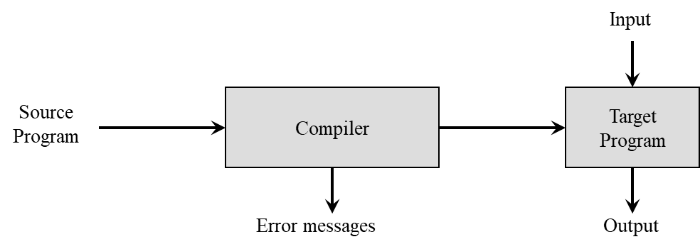
Compiler
“Compilation”
Translation of a program written in a source language into a semantically equivalent program written in a target language

Slide 4
Definition
A compiler is a program translates (or compiles) a program written in a high-level programming language (the source language) that is suitable for human programmers into the low-level machine language (target language) that is required by computers.
During this process, the compiler will also attempt to spot and report obvious programmer mistakes that detect during the translation process.

Slide 5
Why we use High Level Language for Programming?
Using a high-level language for programming has a large impact on how fast programs can be developed. The main reasons for this are:
Compared to machine language, the notation used by programming languages is closer to the way humans think about problems.
The compiler can spot some obvious programming mistakes.
Programs written in a high-level language tend to be shorter than equivalent programs written in machine language.
The same program can be compiled to many different machine languages and, hence, be brought to run on many different machines.

Slide 6
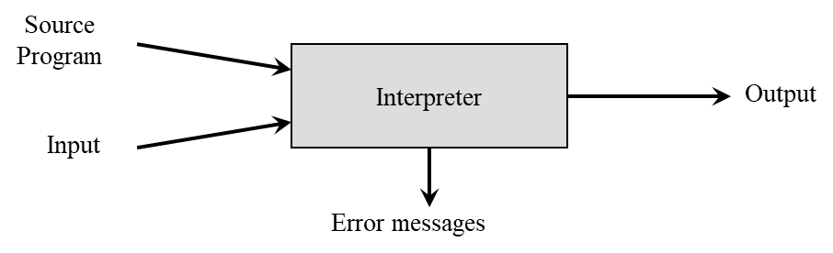
Interpreter
Performing the operations implied by the source program

Slide 7
Compiler vs. Interpreter
Compiler | Interpreter
Takes Entire program as input It is Faster intermediate object code is generated. Required more memory Due to intermediate object code Program not need compile every time Errors are displayed after entire program is checked. Debugging is comparatively hard. Ex: C, C++. | Take single instruction as input It is Slower No intermediate code is generated Required less memory As no intermediate code is generated Every time higher level program is converted into lower level program. Errors are displayed for every instruction interpreted. Debugging is easy. Ex: python, Ruby, basic.

Slide 8
Knowledge Require to build Compiler
Programming Languages
Parameter passing techniques
Scope of variables
Memory allocation techniques
Theory
Automata
Context free languages
Grammers
Algorithms and data structure
Hashing
Graphs
dynamic programming
Computer Architecture
Assembly Language
Software Engineering

Slide 9
The Analysis-Synthesis Model of Compilation
There are two parts to compilation:
Analysis determines the operations implied by the source program which are recorded in a tree structure
Synthesis takes the tree structure and translates the operations therein into the target program

Slide 10
Why Learn About Compiler?
It is considered a topic that you should know in order to be “well-cultured” in computer science.
A good craftsman should know his tools, and compilers are important tools for programmers and computer scientists.
The techniques used for constructing a compiler are useful for other purposes as well.
There is a good chance that a programmer or computer scientist will need to write a compiler or interpreter for a domain-specific language.

Slide 11
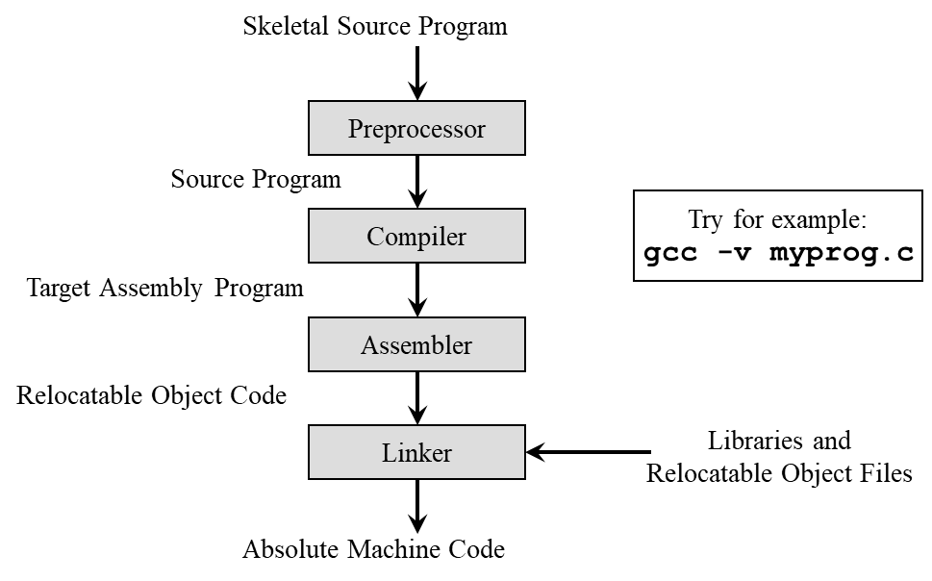
Preprocessors, Compilers, Assemblers, and Linkers

Slide 12
Preprocessor
A source program may be divided into modules stored in separate files and may consist of macros.
Preprocessor produce input to the compiler.
It process the source code before the compilation and produce a code that can be more efficiently used by the compiler.
It cannot be include as the part of single pass compiler.

Slide 13
Example
Sample C Program
#include<stdio.h>
#define min(x,y)
Void fun()
{
Int a = 1;
Int b =2;
Int c;
c = min(a,b)
}
Preprocessor output
Void fun()
{
Int a = 1;
Int b =2;
Int c;
c = if((a)<(b))
Print a;
else
Print b;
}
If the C language program is an input for a preprocessor, then it produces the output as a C program where there are no #include and macors, that is C program only C statement.

Slide 14
Compiler
To convert any high level language to machine code, one translator is mandatory that is nothing but a compiler.
A compiler is translator that convert the high level language into the machine level language,.

Slide 15
Assembler
The third stage is the assembly stage, this stage is to convert the assembly code generated in the second stage into our executable file, which is to convert our assembly language into a machine language that can be executed by our machine.
after opening it through vim, we will find that this is completely confusing to our eyes, but this is a binary language that the machine can understand

Slide 16
Linker
The linker combines all external programs (such as libraries and other shared components) with our program to create a final executable.

Slide 17
See Step by step process
To see what happens after each stage, we will have the process with the following flags
-E : Stop after the preprocessing stage; do not run the compiler proper.
-S : Stop after the stage of compilation proper; do not assemble.
-c : Compile or assemble the source files, but do not link.

Slide 18
Phases of Compiler
Lexical Analysis (Make token Stream)
Syntax Analysis (Syntax Tree)
Semantic Analyzer (syntax Tree)
Intermediate code generator (Intermediate Representation)
Code Optimization (Target Machine Code)
Machine Dependent code optimizer (Target machine code)

Slide 19
Lexical Analysis
Lexical analysis is the process of breaking down the source code of the program into smaller parts, called tokens.
Remove comments
Remove white spaces
Also known as Scanner or tokenizers
Input
Read Character
Lexical Analyzer
Token
Syntax Analyzer
Push Back extra character
Ask for token

Slide 20
Example
A simple statement of C or C++ code
sum = 2 + c;
Create the token of above line
sum | = | 2 | + | C
identifier | Assignment operator | Constant | operator | Identifier

Slide 21
Syntax Analysis (Parser)
The second phase of a compiler is syntax analysis, also known as parsing. This phase takes the stream of tokens generated by the lexical analysis phase and checks whether they conform to the grammar of the programming language. The output of this phase is usually an Abstract Syntax Tree.
AST, is a representation of the structure of a programming language. It is a tree-like structure that is composed of nodes, each of which represents a language element like a variable, operator, or keyword.

Slide 22
Example
sum = 2 * c
Th AST of the given C code will be
=
sum
c
*
2

Slide 23
Semantic Analysis
In semantic analysis, compiler check the logical type error
It checks whether the parse tree follows the rules of language. Semantic analyzer keeps track of identifiers, their types and expressions. The output of semantic analysis phase is the annotated tree syntax.
Notes:
Add actions of the rules

Slide 24
Intermediate Code Generator
compiler generates the source code into the intermediate code. Intermediate code is generated between the high-level language and the machine language.
Convert the code into three address code

Slide 25
Example
sum = 2 * c
Conversion of above statement in intermediate code generator
Temp = 2 *c
Sum = temp;

Slide 26
Code Optimization
Code optimization is an optional phase. It is used to improve the intermediate code so that the output of the program could run faster and take less space.
It removes the unnecessary lines of the code and arranges the sequence of statements in order to speed up the program execution.

Slide 27
Machine Dependent code optimizer
Code generation is the final stage of the compilation process. It takes the optimized intermediate code as input and maps it to the target machine language.
Code generator translates the intermediate code into the machine code of the specified computer.

Slide 28
Example
Example: Register based system
Lets says
R1 = 2
R2 = x
MUL R1 R2
Store sum R1

Slide 29
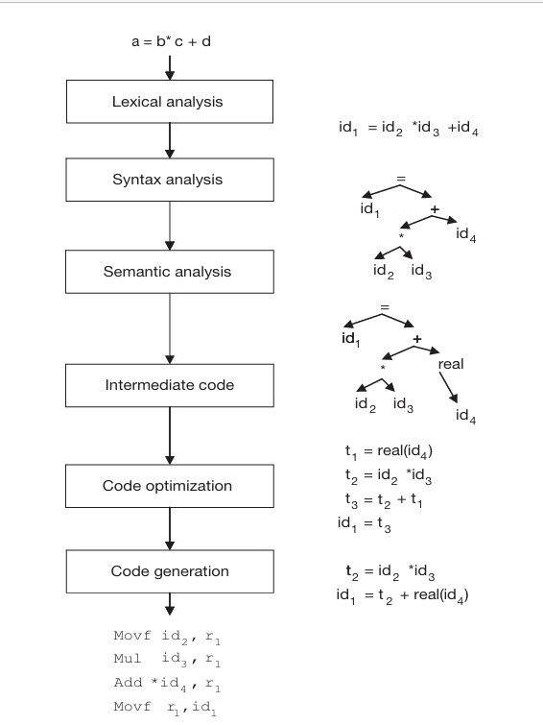
Example: a = b* c + d

Slide 30
Example 2:
Consider the following simple C statement
Price = old + Rate * 50
Grade = Mid1 + Mid2 + Final;

Slide 31
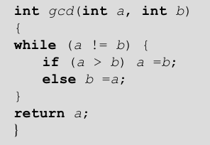
Show the output of each phase of compiler on the following input

Slide 32
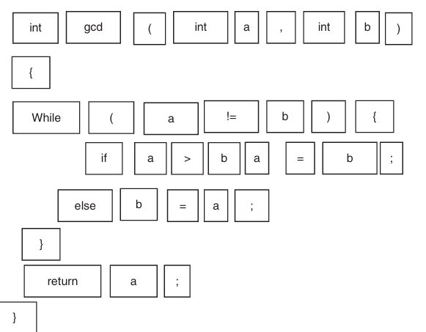
Lexical Analysis

Slide 33
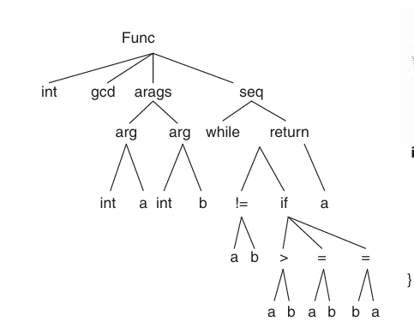
Syntax Analysis

Slide 34
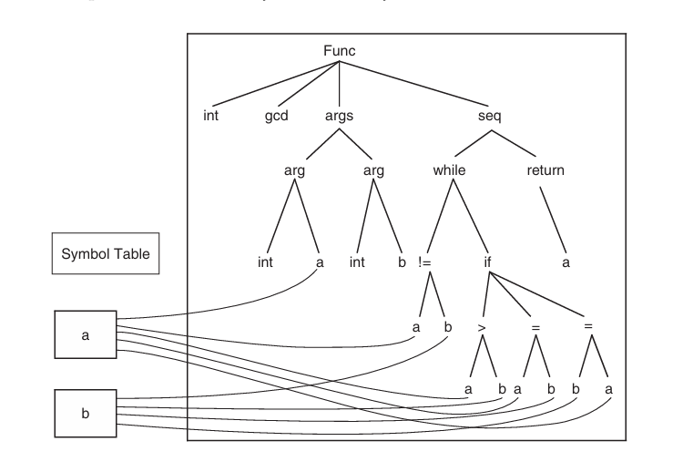
Semantic Analysis

Slide 35
Intermediate code Generator
If (a !=b) go to L1
go to Last
L1: if a > b goto L2
goto L3
L2: a=b
goto Last
L3: b=a
Last: goto calling program

Slide 36
Target Code
mov a, R0 % Load a from stack
mov b, R1 % Load b from stack
cmp, !=, R0,R1
jmp .L1 % while (a != b)
jne .L5 % if (a < b)
subl %edx,%eax % a =b
jmp .L8
L5: subl %eax,%edx % b =a
jmp .L8
L3: leave % Restore SP, BP
ret

Slide 37
Classifications of Compilers
There are three types of compilers
Single pass Compiler
Two Pass Compiler
Multi Pass Compiler

Slide 38
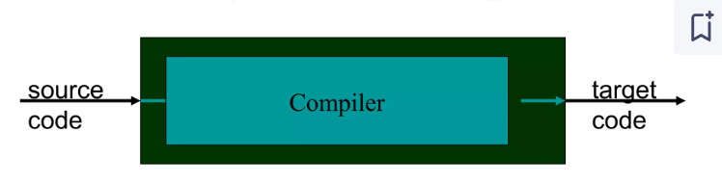
Single Pass Compiler
If we combine or group all the phases of compiler design in a single module known as a single pass compiler.
Source Code Directly transfer to the object code
Example: Pascal

Slide 39
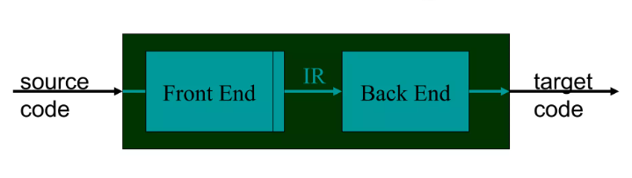
Two-Pass Compiler
Its based on two parts
First Pass is referred as
Front end
Analytic part
Platform independent
Second Pass is referred as
Back end
Synthesis Part
Platform Dependent

Slide 40
Two Pass Compiler
Front End
Lexical Analysis
Syntax Analysis
Semantic Analysis
Intermediate code generation
Back End
Code Optimization
Target Code Generation

Slide 41
Multi Pass Compiler
A multi-pass compiler can process the source code of a program multiple times.
In the first pass
the compiler can read the source code, scan it, extract the tokens and save the result in an output file.
In the second pass
the compiler can read the output file produced by the first pass, build the syntactic tree and implement the syntactical analysis. The output of this phase is a file that includes the syntactical tree.
In the third pass,
the compiler can read the output file produced by the second pass and check that the tree follows the rules of language or not. The output of the semantic analysis phase is the annotated tree syntax. This pass continues until the target output is produced.

Slide 42
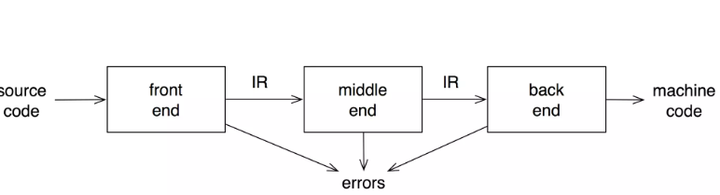
Analyzes and changes IR Goal is to reduce runtime must preserve values

